Slide 1
TEN COMMON REASONS WHY MERGERS FAIL
Overpayment. Some companies feel they must overpay to block a competitive bid or to protect their turf. But when too much is paid, it can kill any chance to achieve a satisfactory return on investment. Lack of strategic clarity. Companies often acquire for the wrong or unclear reasons. For instance, organizations may catch deal fever. They get caught up in a buying frenzy because other companies are making acquisitions. As a result, they do not realistically analyze how a deal will create value. Slow decision-making. It can derail a deal. THERE ARE NO PERFECT Decisions IN M&A, JUST GOOD AND TIMELY ONES.
Lack of buy-in. We’ve all seen situations where the best-laid plans go astray. WELL-CRAFTED Integration plans aren’t worth MUCH if the people who are responsible for executing those plans don’t want to make them work. Culture clash. Even companies in the same industry, serving the same customer segments, and holding the same values can suffer from culture clash. Culture incompatibility is real and can cause a deal to fail just as surely as other more "tangible" reasons.
© PRITCHETT, LP MERGERINTEGRATION.COM SLIDE 1 OF 2

Slide 2
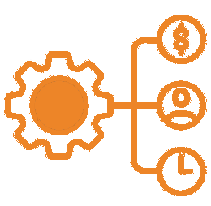
TEN COMMON REASONS WHY MERGERS FAIL
Loss of key customers. Because mergers make the market nervous, competitors may be able to persuade even loyal customers to jump ship.... Erosion of business fundamentals. The urgent demands of integration often take precedence over the day-to-day running of the business. As business fundamentals begin to erode, people tend to blame the problems on the merger. This can begin a vicious downward spiral of reduced revenues, sinking profits, and customer defections. Talent attrition. M&A often gives key talent inside AN organization reason to pause and reconsider their career options. People who might otherwise ignore headhunters may now take their calls.. Under-resourced integrations. Often, the same people responsible for running the business are ALSO tasked with planning and executing the integration. This double workload can burn people out and slow the integration. As a result, some anticipated synergies may be realized late or not at all. Complexity. Some companies overcomplicate their combinations. They tackle too many problems simultaneously. They fail to prioritize. This can lead to a sense of chaos and confusion that frightens people and leaves them unsure of what to do next.
© PRITCHETT, LP MERGERINTEGRATION.COM SLIDE 2 OF 2

