Slide 1
11 COMMON POST-MERGER RISKS
1) Cultural Conflict: Major cultural differences between merging entities can easily lead to friction and misunderstandings that negatively impact employee morale, productivity, and talent retention.
2) Synergy Shortfalls: Merging companies fail to achieve cost and revenue targets because of unrealistic synergy estimates, inadequate integration planning, poor integration execution, and unexpected market changes.
3) Information Technology Challenges: Integrating IT systems from two organizations can cause issues related to data security, data accessibility, and data integrity.
4) Loss of Key Talent: The best employees in an acquired company investigate their career options and are likely to jump ship if they see the merger as bad for their careers.
© PRITCHETT, LP MergerIntegration.com
1

Slide 2
11 COMMON POST-MERGER RISKS
5) Execution Problems: Integrating systems, processes, people, and operations is a complex exercise, and if managed badly, leads to increased costs, a slow integration, and customer and employee dissatisfaction.
6) Customer Attrition: Changes in products, declines in quality or responsiveness, or service disruptions can drive customers to take their business elsewhere.
7) Inadequate Governance: When companies fail to define roles clearly and establish the right decision-making processes, confusion ensues and less is accomplished.
8) Regulatory Issues: Failure to meet legal requirements, which are greater in number and more complex on large or cross-border deals, can result in fines, penalties, and reputational damage.
© PRITCHETT, LP MergerIntegration.com
2

Slide 3
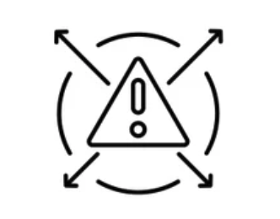
11 COMMON POST-MERGER RISKS
9) Decline in Financial Performance: The changes and uncertainty brought about by a merger can distract employees, which in turn, can reduce their productivity and adversely impact revenues and profits.
10) Damage to Brand Image: Mergers can dilute brand equity and confuse customers especially if communications to the market are unclear and inconsistent.
11) Unnecessary Scope Creep: The addition of non-integration projects to an integration’s scope can overtax integration teams, dilute their focus, lengthen the integration, and threaten a deal’s success.
© PRITCHETT, LP MergerIntegration.com
3

